Slide 1
Clousot & Roslyn
logozzo, maf, mbarnett, schulte, tball

Slide 2

Clousot Architecture
Contract Propagation
Warnings report
Code repairs
Assertion checking
Facts Discovery
IL, Contract Reader
CCI1
CCI2
Roslyn

Slide 3

Dealing with warnings
Suppression
Baseline
Per assembly/type/method level
Per warning type (contract, non-null …)
Ranking
Automatic Code repairs
Use facts to suggest code repairs
Integrated in Roslyn, design-time repairing

Slide 4
Status
Available on Devlabs
3 years, >50,000 downloads, most active project
Community: blogs, forum, bug reports, suggestions …
Core very stable
Routinely on framework libraries
Found many new bugs
Scales up to “monster” MS Dynamics .dll
Size: >80Mbytes, > 192,000 classes, ~700,000 methods,
Full analysis: < 1 day
Found new bugs

Slide 5
Backup slides

Slide 6
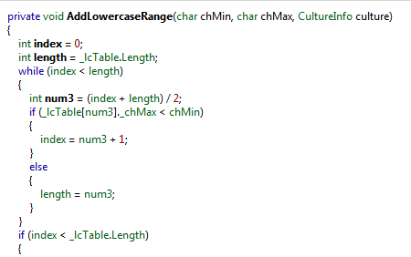
System.dll overflow

Slide 7
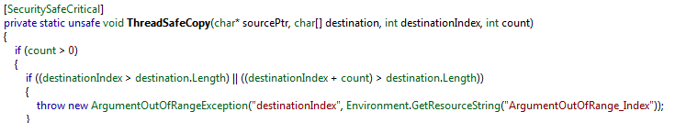
mscorlib overflow (stringbuilder)

Slide 8
Bug list
Framework libraries
OneNote:1 2 3 4 5 6 7
R++ Microsoft Dynamics
OneNote: 1

